Slide 1
C/C++ Programming in a UNIX Environment
CS 3377
Bhanu Kapoor, PhD
Department of Computer Science University of Texas, Dallas, TX bhanu.kapoor@utdallas.edu
Notes Week 10
1

Slide 2
Reading for Week 10
Chapter 10 of A Practical Guide to Linux® Commands, Editors, and Shell Programming, Third Edition. Mark G. Sobell.
◼ Chapter 10: The Bourne Again Shell
Prepare for Midterm Exam
Midterm Exam on lecture notes and Chapter 10: March 23 @7:30 PM
1

Slide 3
Agenda
More on bash functions
More on Random # Generation
Loop Constructs
1

Slide 4
Functions
□ The syntax that declares a shell function is
[function] function-name ()
{
commands
}
where the word function is optional, function- name is the name you use to call the function, and commands comprise the list of commands the function executes when you call it. The commands can be anything you would include in a shell script, including calls to other functions.
1

Slide 5
Function Example
$ function whoson ()
{
date
echo "Users Currently Logged On"
who
}
$ whoson
Sun Aug 9 15:44:58 PDT 2009
Users Currently Logged On
hls | console | Aug 8 08:59 | (:0)
max | pts/4 | Aug 8 09:33 | (0.0)
1

Slide 6
Function
#!/bin/bash echo hello
whoson ()
{
date
echo "Users Currently Logged On" who
}
whoson
1

Slide 7
Functions
#!/bin/bash
func1 () { echo “Hello, World!";} func1
func2 ()
{
i=0;
max=20;
while [ $i -lt $max ]
do echo "Hello, World!“ let “i+=1”
done
}
func2
1

Slide 8
Functions cannot be empty
#!/bin/bash
# empty-function.sh empty ()
{ }
syntax error near unexpected token `}' # empty-function.sh: line 6: `}'
1

Slide 9
Functions
#!/bin/bash func3()
{
echo "Enter the search string:" read string
echo "Enter the file name:" read filename
grep -n "$string" $filename
}
func3
1

Slide 10
Functions
#!/bin/bash func4()
{
echo "Enter a directory name: " read directory
mkdir $directory
for file in *.c do
echo "Filename==>$file“
cp $file $directory done
}
10
func4

Slide 11
Generating Random #s in bash
$RANDOM returns a different random integer at each call
echo $RANDOM to experiment with it
Nominal range: 0 - 32767 (signed 16-bit integer)
How would your generate numbers between say 0 and 100?

Slide 12
Random #s
□ MAX=100
number=$RANDOM
let "number %= $MAX"
echo $number

Slide 13
Useful Shell Programming
Constructs
Control Structures
if…then, if…then…else, if…then…elif, case
Loops
for, while, until

Slide 14
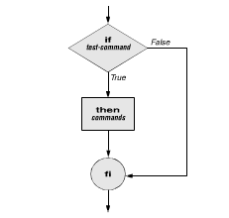
Control Structures
if…then
Syntax and Example
if test-command then
commands
fi
if [ $x = $y ] then
echo “Equal values found”
fi

Slide 15
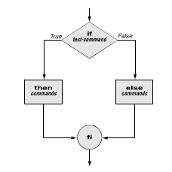
Control Structures
if…then…else
Syntax and Example
if test-command then
commands else commands fi
if [ $x = $y ] then
echo “Equal values found”
else
echo “Unequal values”
15
fi

Slide 16
File test options
Option Tests file to see if it
–d Exists and is a directory file
–e Exists
–f Exists and is an ordinary file (not a directory)
–r Exists and is readable
–s Exists and has a size greater than 0 bytes
–w Exists and is writable
–x Exists and is executable

Slide 17
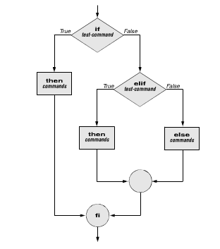
Control Structures
If…then…elif
Syntax and Example
if test-command then
commands
elif test-command
then commands
. . .
else commands fi

Slide 18
Control Structures
#!/bin/bash
# This script will test if we're in a leap year or not. year=`date +%Y`
if [ $[$year % 400] -eq "0" ]; then
echo "This is a leap year. February has 29 days."
elif [ $[$year % 4] -eq 0 ]; then
if [ $[$year % 100] -ne 0 ]; then
echo "This is a leap year, February has 29 days." else
echo "This is not a leap year. February has 28 days." fi
else
echo "This is not a leap year. February has 28 days."
18
fi

Slide 19
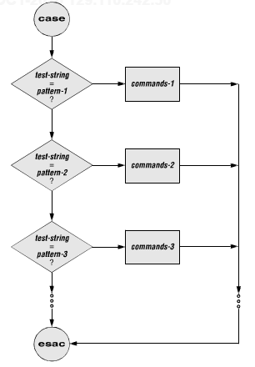
Control Structures: Case
□ Syntax
case test-string in
pattern-1) commands-1
;;
pattern-2) commands-2
;;
pattern-3) commands-3
;;
. . .
esac

Slide 20
Control Structures: Case
□ Example
echo -n "Enter A, B, or C: "
read letter
case "$letter" in A)
echo "You entered A"
;;
B)
echo "You entered B"
;; C)
echo "You entered C"
;;
*)
echo "You did not enter A, B, or C"
;;
esac

Slide 21
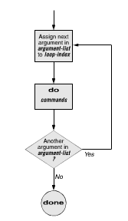
Loops: for
for…do…done
Syntax and Example
for loop-index in argument-list do
commands
done
for fruit in apples oranges pears bananas do
echo "$fruit" done
echo "Task complete.

Slide 22
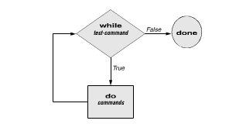
Loops: while
while…do…done
Syntax and Example
while test-command do
commands
done
number=0
while [ "$number" -lt 10 ] do
echo -n "$number" ((number +=1))
done

Slide 23
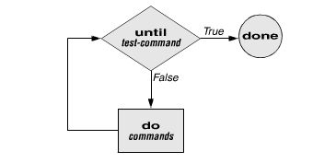
Loops: Until
Until…do..done
Syntax and Example
until test-command do
commands
done
number=0
until [ "$number" = 10 ] do
echo -n "$number" ((number +=1)) done

